Slide 1
Deploy or Die in a DevOps World: High-Availability is No Excuse!
Natalie Diggins,
VP Cloud Strategy and Platform

Slide 2


How I Learned DevOps
GST (CLEC)
1997-1999
1999-2002
STABILITY
INNOVATION
Notes:
Image: two-headed arrow showing a spectrum with “stability” at one end and “innovation” at the other
Stability – Local Carrier 1997-1999
Innovation – Founded my own company – 1999-2002

Slide 3
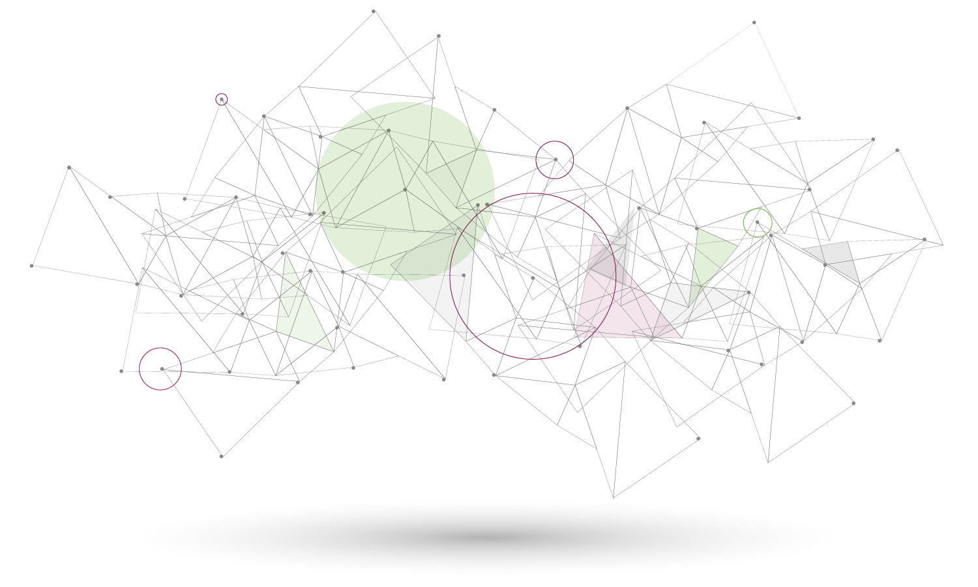
Neustar Is…
The first real-time provider of cloud-based information services and analytics, enabling marketing and IT security professionals to promote and protect their businesses.
Notes:
The Situation at Neustar
My mission: Guide cultural and technical transformation in DevOps at Neustar
Include some boiler plate on company

Slide 4





The DevOps Problem at Neustar
How to
Scale?
STABILITY
INNOVATION
Notes:
Legacy Business – the 5 9s imperative
7 Acquisitions over three years
Increasing need for speed and innovation

Slide 5
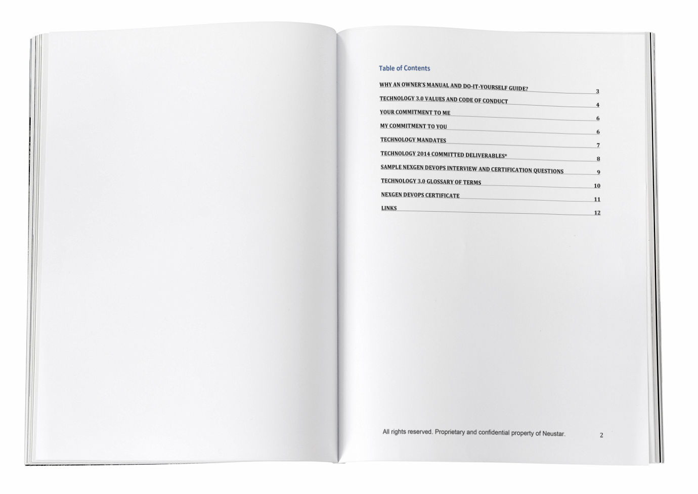
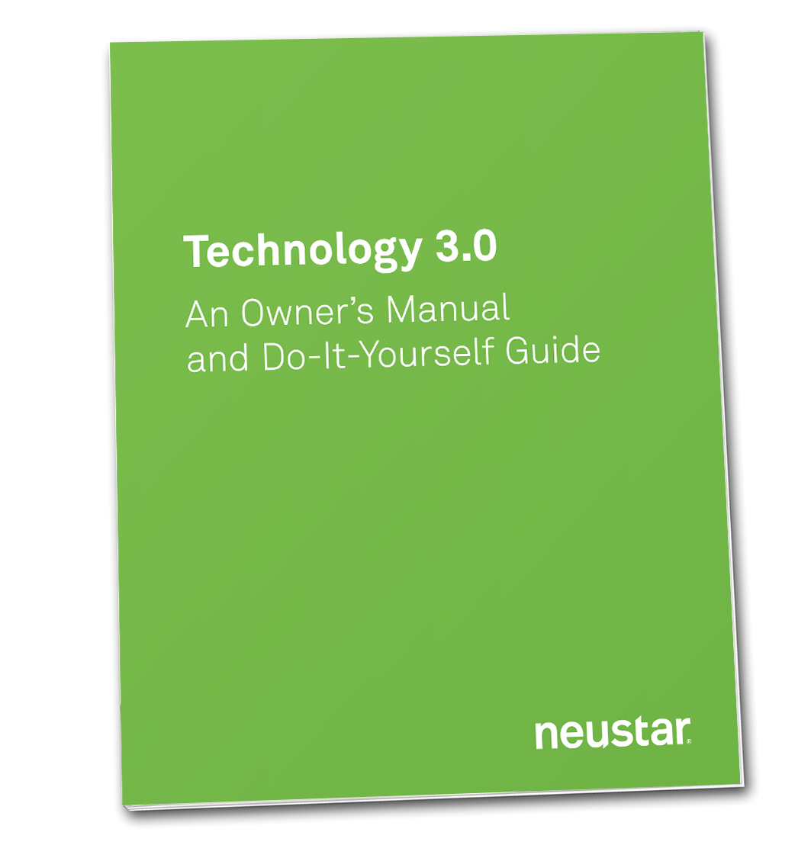
Solution: Technology 3.0
To Change Culture & Technology requires:
Cloud + platform + tools + adoption
Notes:
To Transform DevOps requires changing Culture +Technology
Cloud + platform + tools + adoption

Slide 6
COMMON VALUES
Customers are always first
Technology is accountable
Automation
Simple is better
Embrace Open Source
There is no “I” in TEAM
Commitment to quality and stability
Notes:
Customers are always first
Technology is ultimately accountable for business outcomes. We go above and beyond.
We relentlessly pursue automation.
Simple is better.
We enthusiastically embrace Open Source.
There is no “I” in TEAM. We respect our peers in Technology and the Business, and we win or lose together.
We have a steadfast commitment to quality and stability

Slide 7
Common Platform, Tools, and DevOps
Applications: DevOps
But not every Product is a candidate for every Technology 3.0 service
SaaS
Platform and Tools: 15 platform services, 10+ Tools
PaaS
Infrastructure: Full cloud, hybrid, our own metal
IaaS
Notes:
HAVE THIS DIAGRAM BUILD AS “STACK” WITH THE BOTTOM APPEARING FIRST
Applications: Metrics, logging, monitoring
Platform and Tools: 15 platform services, 10+ Tools
Infrastructure: Full cloud, hybrid, our own metal
APPEAR OVERLAY ON CLICK - But not every Product is a candidate for every Technology 3.0 service

Slide 8

DevOps:
This is hard. REALLY HARD.
We looked at three-models
The pure start-up model
Google SRE model
Hybrid
We’re crafting our own model – Still a work in progress
Notes:
This is hard. REALLY HARD.
We looked at three-models
The pure start-up model
Google SRE model
Hybrid
We crafted our own model

Slide 9
Solution: Adoption Matrix
 | Product 1 | Product 2 | Product 3 | … | Product 35+
Software Build Tools
Tool 1
Tool 2
Tool 3
Platform Services
Service 1
Service 2
Service 3
… (total of 30 tools/services in 5 categories)
Rating | Meaning
0 | Can not use – remove from denominator
1 | Not Using
2 | Work in Process
3 | Not Ideal Usage
4 | Satisfactory
5 | Ideal Usage
Brad, Screenshot coming.

Slide 10
Solution: Adoption Matrix Summary
 | Product 1 | Product 2 | Product 3 | … | Product 35+
Software Build Tools | 75% | … | … |  | …
Platform Services | 50% | … | … |  | …
…
Total Adoption Score | 60% | … | … |  | …
Number of Services Used | 25 | … | … |  | …
Number of Services that Can Not Be Used | 5 | … | … |  | …
Brad, Screenshot coming.

Slide 11

Our Learnings
Hit
Ring fencing sensitive applications and recognizing one size doesn’t fit all
Hit
Building the adoption matrix
Needs Improvement
Gaining understanding and buy-in
Needs Improvement
Ongoing communication
Notes:
Hit – Ring fencing sensitive applications and recognizing one size doesn’t fit all
Hit – Building the adoption matrix
Need improvement – Gaining understanding and buy-in
Need improvement – Ongoing communication

Slide 12
Next Steps
This is a holistic process.
The framework is in place for ongoing execution
Continue developing metrics that show business value
Notes:
This is a holistic process.
The framework is in place for ongoing execution
Continue developing metrics that show business value

Slide 13

THANKS.
Questions and Answers
natalie.diggins@neustar.biz

